Slide 1


FOREST FIRE DETECTION USING DEEP LEARNING
NAME:POORNIMA M
AICTE_ID: STU67cc113460d051741426996

Slide 2

Learning Objectives
1. Understand the Importance of Forest Fire Detection:
- Explain the ecological and economic impacts of forest fires.
2. Familiarize with Deep Learning Concepts:
- Define deep learning and its relevance to image classification tasks.
- Introduce key concepts such as neural networks, convolutional layers, and activation functions.
3. Explore the Dataset:
- Describe the dataset sourced from Kaggle, including its structure and the two classes: "fire" and "no fire."
4. Implement a Deep Learning Model:
- Outline the steps to build a convolutional neural network (CNN) for fire detection.
- Explain the choice of architecture and hyperparameters.
GOAL
Source :
www.freepik.com/

Slide 3
Tools and Technology used
Programming Language: Python – A widely used language in machine learning for its simplicity and strong library support. Used for data preprocessing, model building, and evaluation.
Frameworks & Libraries: TensorFlow – Open-source deep learning framework by Google, suitable for building and training models. Keras – High-level API on top of TensorFlow, simplifies neural network design.
Other Libraries – NumPy, Pandas (data handling), Matplotlib, Seaborn (visualization), OpenCV (image processing, if applicable).
Development Environment: Google Colab – Cloud-based Jupyter notebook platform with free GPU/TPU support. Easy to use, no local setup needed, ideal for collaboration.
Dataset: Kaggle – A source of public datasets. Forest fire datasets may include:
Satellite or drone images (fire/no fire)

Slide 4
Methodology
1.Data collection I collected data from Kaggle, including satellite images and environmental sensor data like temperature and humidity.
Data Preprocessing I cleaned the dataset by handling missing values, normalized the features, encoded the labels, and resized and augmented images. I also split the data into training, validation, and test sets.
Model Selection I selected a suitable model based on the data type—CNN for image data, and other machine learning models for structured data. In some cases, I used pre-trained models to improve performance.
Model Training I trained the model using TensorFlow and Keras, applied optimizers like Adam, and tuned hyperparameters such as learning rate and batch size.
Evaluation I evaluated the model using metrics like accuracy, precision, recall, F1-score, and confusion matrix to assess its performance.
Validation I used a validation set and applied techniques like cross-validation and early stopping to prevent overfitting and improve generalization.

Slide 5
Problem Statement:
Forest fires are becoming increasingly frequent and severe due to climate change, threatening ecosystems, wildlife, and human lives. I observed that traditional detection methods are often slow and reactive, leading to significant damage before action is taken. Through this project, I aim to develop an intelligent, real-time forest fire detection system using deep learning. By analyzing environmental data and imagery, my goal is to enable faster and more accurate fire detection, supporting early intervention and minimizing disaster impact.

Slide 6
Solution:
1,Classifying Fire vs. No-Fire I built a model to classify data into fire and no-fire categories.
Achieving 76.8% Accuracy The model achieved 76.8% accuracy, ensuring reliable fire detection.
Real-Time Detection The system enables quick fire identification, supporting faster response times.
Optimizing Performance I used CNNs for image classification and tuned the model for speed and accuracy.
Future Improvements I plan to expand the dataset and explore transfer learning to boost performance.
https://github.com/PoornimaRaj0000/week1.git

Slide 7
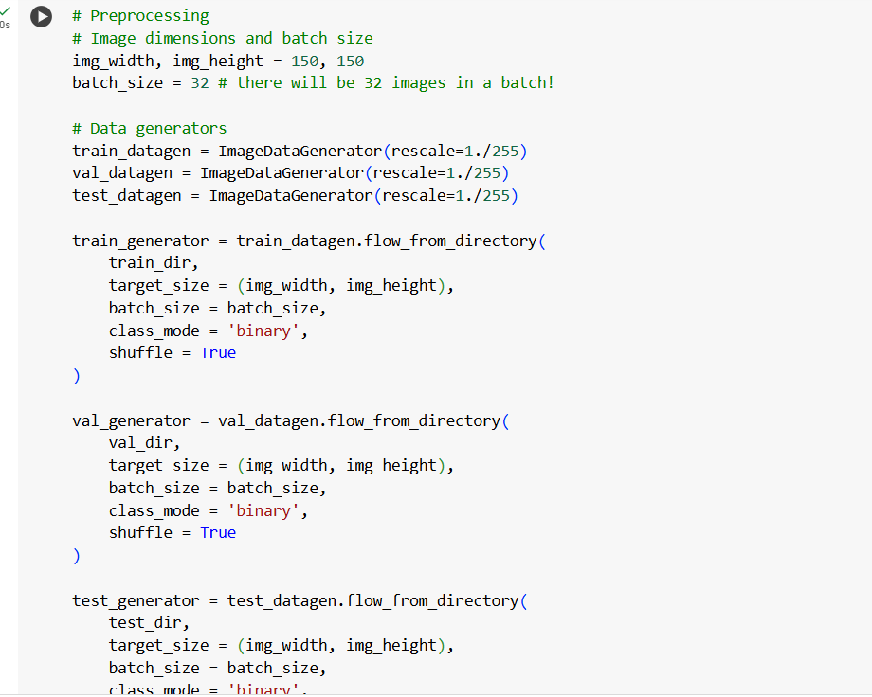
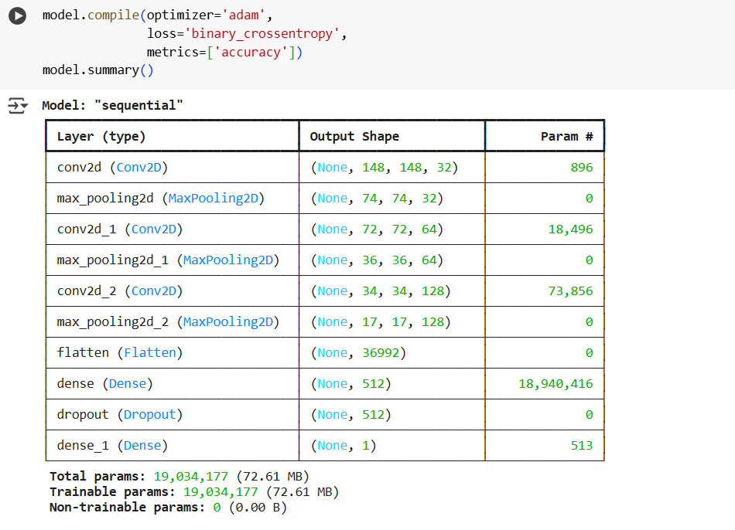
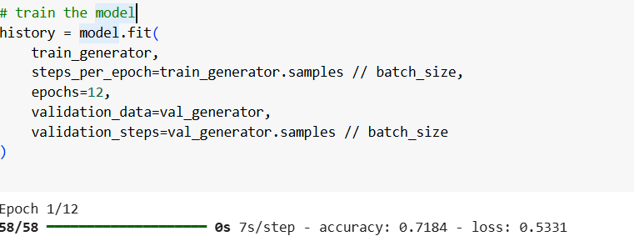
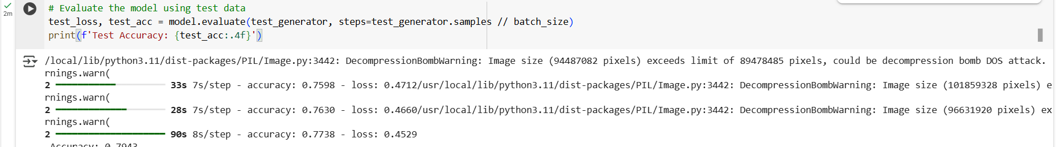
Screenshot of Output:

Slide 8
Conclusion:
I developed a deep learning model that detects forest fires from images with about 76.8% accuracy, improving monitoring speed and reducing human error compared to manual methods. For future scopes, I plan to implement real-time detection using satellite or drone data, develop a mobile or web alert application, expand the model to classify fire severity, incorporate environmental factors to enhance accuracy, apply transfer learning with advanced architectures, and optimize the model for deployment on edge devices to enable remote and low-power monitoring.

